Slide 1
Global Grants Training
TITLE
Jim Roxlo, D6780
jim@roxlo.com
423-774-3183
October 26, 2024

Slide 2
Today’s Agenda
  Part 1: Why be involved in a Global Grant?
  Part 2: Defining and designing a project
  Part 3: Completing a Grant Application
Which parts are important to you?

Slide 3
Why do a Global Grant?
Notes:
DDF and WF available to help – big time. With the end of Polio coming soon, we need to build our capability to do grants. We have big players, like B&MG that are ready to help if we can do it.

Slide 4
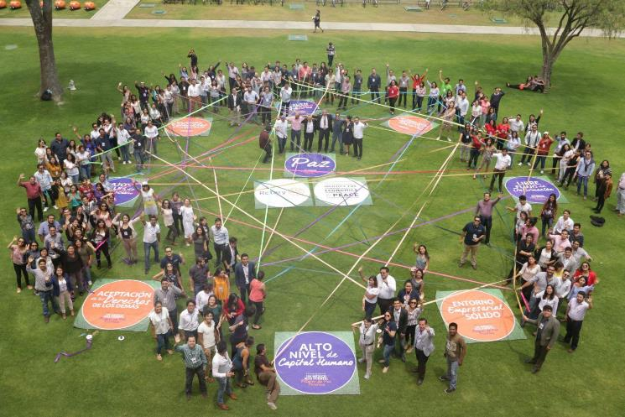

Positive Peace Workshops – two in Mexico, one in Columbia, and one in the US
Build Peace
Notes:
308 youth participated Peace. This is the 2nd. One- for 150 young people and Rotaractors. All 7 Rotary Districts in Mexico. Will do Train the Trainer and 2 follow up trainings with 2nd grant. Districts 6780, 6800, and 6710 gave $7,500 DDF each. District 6860 gave $2,500 DDF. WF match =$74,670

Slide 5
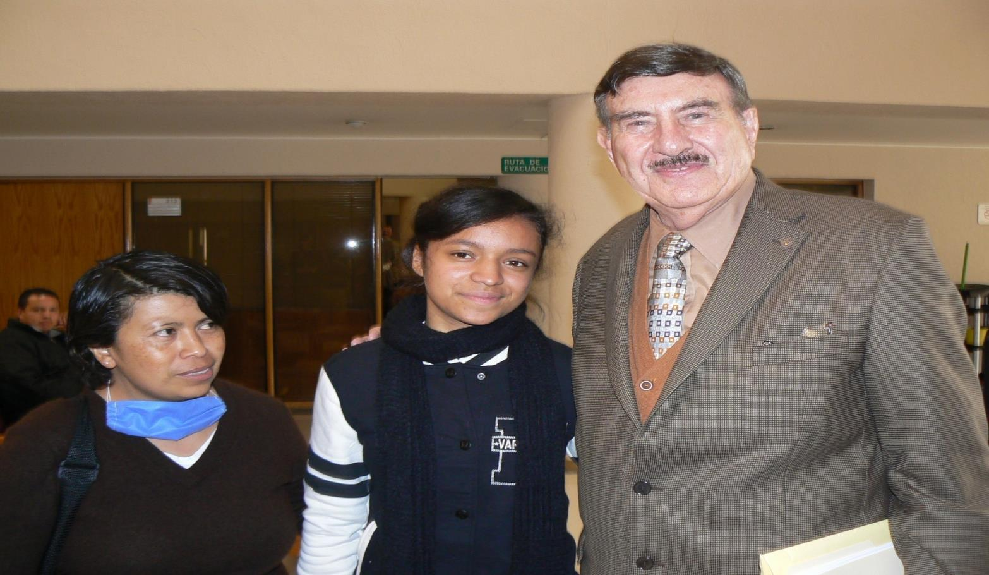
Save Lives
GG#1860594 Cost Effective Kidney Transplants
Notes:
Holtz-Beahon Kidney transplant Grants for people outside the health system. This young lady is 15 and 9 days after surgery. Nacho Holtz
Districts 6760 and 6710 gave $6,000 DDF each and District 6780 gave $4,050 DDF each. WF match was: $90,350

Slide 6
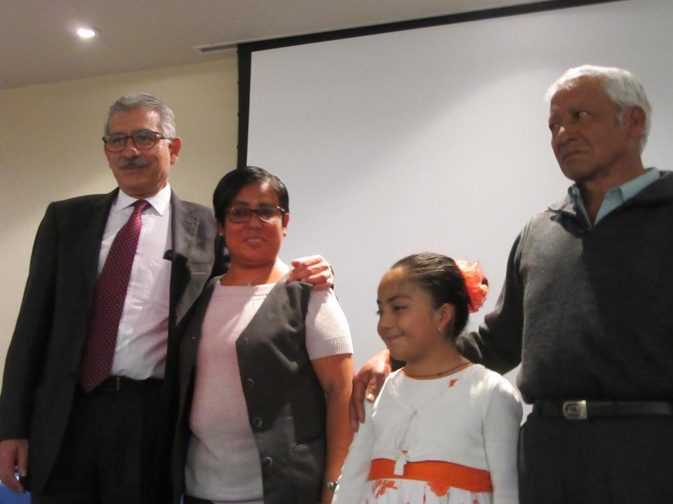
Meet the Beneficiaries
Notes:
Doctor, first recipient, daughter and Dad donor

Slide 7
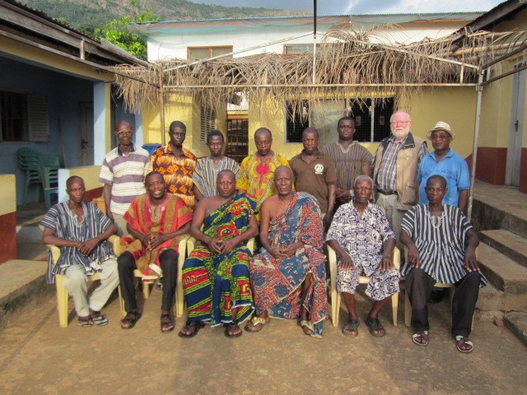
Build a Health Center and bring a community together
The Oak Ridge Global Grant in Ghana brought together all the tribal chiefs to agree to support the Health Center

Slide 8
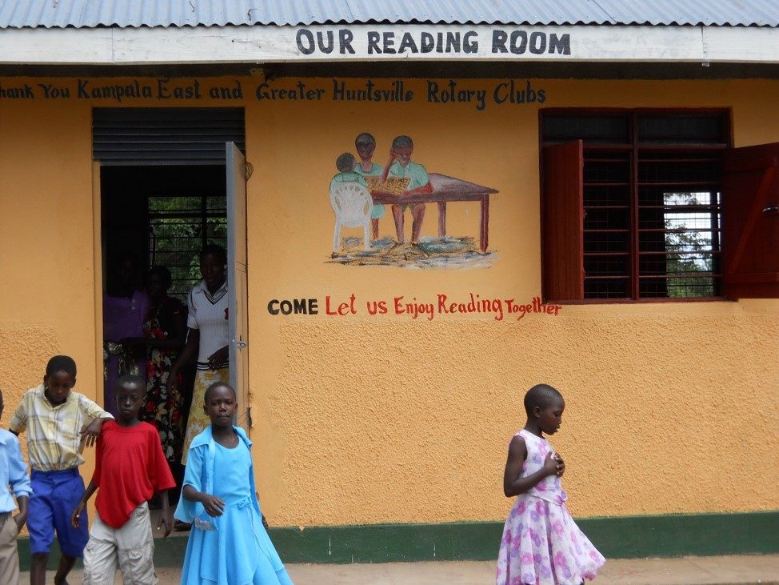
Provide Basic Education
GG 1873073
Sam Owori Memorial School
in Uganda
$62,323
Notes:
Districts 6860 gave 3,987
Districts 6780, 6880, 6760, 6800, and 6710 gave $1,200 each
WF match = $31, 036

Slide 9
Projects in U.S.
Global grants supported (“Reverse Global Grants”)
Kentucky D6740 Water and Sanitation project
Illinois D6490 anti-bullying
Rotaract Positive Peace Workshop
Notes:
Disaster recovery trailer –clean and safe water and food for victims and volunteers. Hot Meals, FEMA, Salvation Army, Rotary. Have training programs for Rotarians. Teaching kids in Illinois about gender sensitivity. If concept continues, would like to be a model.

Slide 10
What Global Grants have you been involved in?
Please briefly share the following:
1. What country?
2. What Area of Focus?
3. Was it fun?

Slide 11
So why be involved in Global Grants?
In-depth Understanding
Significant Impact
Memorable Fun

Slide 12
End of Part 1
Questions?

Slide 13
What does it take to make a Global Grant become reality?

Slide 14
Defining and Designing your Project

Slide 15

We often start here:
My club wants a Global Grant but we don’t know where to start!

Slide 16

Then we look at the Application!
Focus Area
Sustainability
Stewardship
Needs assessment
Partners
Beneficiaries
Funding
Too many tabs!
So many questions!
Too Complicated!

Slide 17
Projects to join
Join another club that is developing a Global Grant project
Find a club overseas with a project that needs an International Partner with money
Help fund Global Grants that have been developed by others. For example: Heart 2 Heart
References:
https://www.rizones30-31.org/news/heart-2-heart/
www.matchinggrants.org

Slide 18
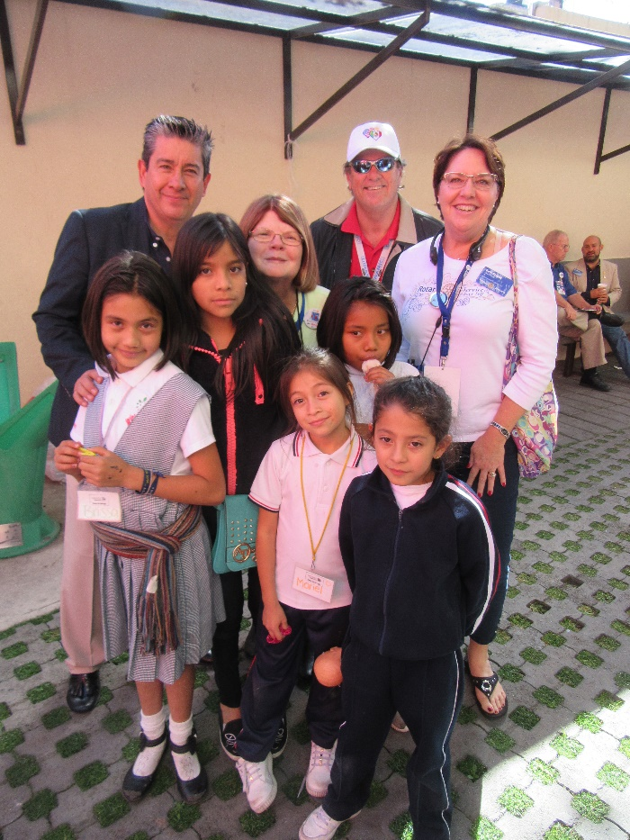
Example of a Project to join: Heart 2 Heart
D4170 (Mexico City) and Zones 30-31
15-year growing relationship
6-10 Global Grants per year
$1MM per year total project cost
Annual pilgrimage in January

Slide 19
Projects you have joined
Please tell us the following:
1. Briefly describe a Global Grant project your club has
joined with another club or district
2. What you personally got out of helping with that
Global Grant project

Slide 20

Some of us are now here
That’s all nice but we want to have our own project!

Slide 21
Be prepared to have your team:
Be persistent
Make multiple contacts with your Host Sponsor
Find a way to do a Community Assessment in country
Contact the RI staff member in charge of grants in that country
Spend hours writing the grant application
Be disappointed when the grant comes back to you for revision
Be diligent with respect to the grant funds
Be overwhelmed with awe when you see the results
Notes:
ok

Slide 22
The Rotary Foundation’s Grants are Different
The funding comes to the Foundation from Rotarians
The grants are given to Rotary Clubs to spend
The partnership of two clubs in different countries is a primary aim of the project
An NGO can join the project as a cooperating organization, but the primary responsibility remains with the two clubs

Slide 23
Suggestions for the International Partner
Find a team of people in your club who are passionate about doing International service.
Find a project that all of you can get excited about.
Don’t start the application until you know what you want to do!
Be thinking about fundraising projects and other ways to fund the grant.
Notes:
I don’t like Principle 4

Slide 24
Important!!
Don’t let the funding define your project
Find a good project and then get the funding
We need big projects to be successful
Bigger projects are easier to fund

Slide 25
Develop your project
Where
Who
What
Area of Focus
Goals
Short summary

Slide 26
Where is your project?
Do you have a traveler?
  Someone who frequently visits another country
  Has time to visit potential project areas
  Can visit Rotary clubs
Can you travel with others?
  Churches
  Non-Profit organizations
  Other Rotary clubs
  Use a Group Study Exchange
  All of this travel can be paid for with a District Grant

Slide 27
Find a Host Sponsor
Determine what club (from the country you want to do the grant in) will be best to partner with:
Active and experienced in Grants
Willing to work with your club
Accepting a balanced relationship
Are District and Club qualified?
Build a personal relationship from the beginning!

Slide 28
Find potential project areas
Check RI for other projects in country
Ask local officials if they have a needs assessment
Do the clubs have ideas?
Is there a specific population in need?
Are there local community health committees?

Slide 29
Determine beneficiaries
Beneficiaries are people, not organizations
Can you count them?
What do they need the most?

Slide 30
Perform a Community Assessment
Work with the local club
Involve community health groups and governments
Consider both assets and needs of the community
Include Positive Peace in your assessment
Select a project
  Near the top of the needs list
  Time and scope of work interesting to the clubs
  Do you need special expertise?
  Relevant examples of success
  Aligned with one of the seven Areas of Focus
Community assessment can be covered by District Grant References:
Community Assessment Form
Positive Peace Design Tool

Slide 31
Areas of Focus and Goals
Areas of Focus are focused by the trustees
It’s best to have only one Area of Focus
Review Areas of Focus Policy Statements for alignment with your project
Pick specific goals you will be aligned with
Reference:
Areas of Focus Policy Statements

Slide 32
Rotary International’s Seven Areas of Focus
Peace and conflict prevention/resolution
Disease prevention and treatment
Water and sanitation
Maternal and child health
Basic education and literacy
Community economic development
Supporting the Environment

Slide 33


Rotary’s Seven Areas of Focus
Notes:
PAS: Remember we now have 7 areas of focus, as we added the Environment.

Slide 34
Policy – Water and Sanitation
Area of Focus Statement of Purpose and Goals
TRF enables Rotarians to ensure communities’ sustainable access to water, sanitation, and hygiene by:
Facilitating universal and equitable access to safe and affordable drinking water
Improving water quality by protecting and maintaining surface- and groundwater resources, reducing pollution and contaminants, and promoting wastewater reuse
Facilitating universal and equitable access to improved sanitation and waste management services in order to achieve open defecation-free communities
Improving community hygiene knowledge, behaviors, and practices that help prevent the spread of disease
Strengthening the capacity of governments, institutions, and communities to develop, finance, manage, and maintain sustainable water and sanitation services

Slide 35
Steps of the Process
You can take these steps in any order
  Location
  Partner
  Beneficiaries and Needs
  Project Selection
  Area of Focus and Goals
Review these steps as you go
Review them again when you have them all in place

Slide 36
Define your Project
Combine the work so far into a 2-sentence summary like this:
The Rotary Clubs of Butuan, Philippines and Jefferson City West, Missouri, USA will partner with Global Action Platform to provide community and economic development training for an initial 30,000 Indigenous People in the Caraga region of the island of Mindanao in the Philippines. This project is the first stage in a long-term program to provide these same skills and knowledge to about 1 million Indigenous People in the Caraga region in the coming years.

Slide 37
End of Part 2
Questions?

Slide 38
Conclusion of Defining your Project
Yay!!!
Break Time
Global Grant Application Template

Slide 39
Completing a Global Grant Application

Slide 40
Can be Overwhelming at first
Talk to the Grants Staff member for the country of your project
  Oh, no!
  So much information I need to know!
References:
Grants Staff Contacts

Slide 41
Global Grant Application Template
Start with the on-line template, not the Grant Module
Editable Word document
Easy to share and collaborate
When you have good alignment with your partners and most of the fields are complete, you can easily transfer to the Grant Module
References:
Global Grant Application Template

Slide 42
Global Grant Application Tabs / Steps
Basic Information
Committee Members
Project Overview
Areas of Focus
Measuring Success
Location and Dates
Participants
Budget
Funding
Sustainability
Review and Lock
Authorizations

Slide 43
Do the easy items first
Delete fields you don’t need for a Humanitarian grant
  1. All fields related to VTT ( in Steps 6, 7, 10)
  2. All fields related to Scholarships (in Steps 6, 7, 10)
Fill in the fields you can do now
Most of steps 1, 3, 4, 5 and 6

Slide 44
Identify the Team Members
Step 2 Committee Members
  1. Committee members for host club (in the country where the project will be implemented)
  2. Committee members for international club (in another country; only one international club allowed)
Step 7 Participants
  1. Cooperating Organizations (usually needed for technical expertise) MOU required.
  2. Other Partners (other Rotary groups or individuals who will work on the project, usually not needed)
  3. Volunteer travelers (specialists, not typical Rotarians doing project oversight, usually not needed)

Slide 45
Memorandum of Understanding
Step 7 Participants
Must have an MOU signed by the Host Sponsor, International Sponsor and the Cooperating Organization if there is one or two.
The MOU designates the responsibilities of :
The Host Sponsor
The International Sponsor
The Cooperating Organization

Slide 46
Host Sponsor’s Responsibilities
Provide technical and professional services in support of the Rotary Grant project
Provide volunteer training, mentoring, and financial review
Direct and coordinate local community education and public relations
Seek community support and resources for the project
Host visiting Rotarians who come to support or learn about the Rotary Grant project
Manage the grant funds and pay suppliers, vendors, or contractors
Prepare Rotary Grant project reports, in cooperation with the International Sponsor
Measure and evaluate project activities

Slide 47
International Sponsor’s Responsibilities
Direct and coordinate community education and public relations
Direct and coordinate International fundraising efforts
Travel to the project location to provide technical or professional service
Maintain the master schedule of events
Contact the Host partner and (optional) cooperating organization at least monthly to discuss progress and milestones
Assist the Host Sponsor in implementing and reporting on the Rotary grant project and ensure progress reports are timely
Issue monthly reports to leaders of both clubs and districts, plus key people in the relationship. Include a summary of contacts, milestones and accomplishments.

Slide 48
Cooperating Organization’s Responsibilities
Provide expertise, infrastructure, advocacy, training, education, or other support for the Rotary Grant project
Submit itemized expense statements and receipts to the Host Sponsor or International Sponsor for reimbursement
Maintain sufficient records and data to complete reports to the Rotary Foundation
Report activities and results to the Host Sponsor and International Sponsor accurately and in a timely way
Measure and evaluate project activities
Continue to support the project financially or programmatically after Rotary Grant funding ends

Slide 49
What could go wrong?
Because there may be many entities involved in implementing a Global Grant, what could go wrong and how would you handle the situation?

Slide 50
Conflict of Interest
Step 2 - See COI definition
1. Does your club have potential conflicts of interest?
2. How do you identify them?
3. How do you control them?
4. Does your partner club have potential conflicts of interest?

Slide 51
Project Plan
1. Develop an overall project plan with all the steps you know now. It will be used several places.
2. This plan is an important document. Identify all the steps you will need to make your project a success.
3. What elements need to be included?
Notes:
Title?

Slide 52
Sustainability
Step 10 Sustainability
Start with the community assessment
Respect natural resources
Train the beneficiaries
Use local labor
Buy locally
Establish a maintenance plan
Train a monitoring group or person
Reference:
Six Steps to Sustainability

Slide 53
Stewardship
1. Who is responsible for project funds and successful project completion?
2. How do you exercise responsibility?

Slide 54
Contingency Planning
This is a critical part of Stewardship
1. What do you do if you have a financial overrun?
  How could it happen?
2. What do you do if you have reporting issues?
3. What do you do if you have a communication problem?

Slide 55
Monitoring, Evaluating, and Reporting
A critical part of Stewardship
1. How will you monitor the project?
- Observations, verbal reports, data?
2. How do you evaluate what you know?
3. Who will do the reporting?
Best Practice:
Link reporting to events, not the calendar.

Slide 56
Measuring Success
Step 5 Measuring Success
1. Review standard measures in the Monitoring and Evaluation Plan Supplement
2. Select standard measures
3. Consider whether you should add measures based on sustainability and contingency planning
Reference:
Global Grant Monitoring and Evaluation Plan Supplement

Slide 57
Budget
Step 8 Budget
Expense Categories:
  Accommodations
  Equipment
  Monitoring and Evaluation
  Operations
  Personnel
  Project Management
  Publicity
  Signage
  Supplies
  Training
  Travel
  Tuition
Notes:
ok

Slide 58
Funding
Step 9 Funding
Do you have sufficient funding for the project?
Does your District have as many global grants as it wants?
Does your District have funds available for more Global Grants?
Where can you get additional funding?
Work with your District leaders to get the funding you need

Slide 59
Funding Exercise
You are working on a Global Grant creating a water well for an orphanage in Sierra Leone. The project budget is $45,000. Your club has raised $7,000. Your District Foundation Chair will match club cash 2:1. Another district has contributed $5,000 to your Global Grant project. A Rotarian from another club has given her Paul Harris Society contribution of $1000 to your Global Grant. The World Fund will match DDF at 0.8:1 but not cash. Do you have enough funding to submit the grant?
$ 7,000
14,000
5,000
1,000
15,200
$42,200
Notes:
1:2

Slide 60
Approval Steps
The two primary contacts (see Tab 1) review and approve and then the application is LOCKED (Tab 11)
All contributing Districts approve the DDF. (DG and DRFC in Tab 12)
The lead Districts DRFCs approve the grant for TRF compliance (Tab 12)
The application is SUBMITTED.
Partners sign to confirm acceptance of responsibility.
The application is reviewed, maybe revised, and APPROVED.
Partners set up banking instructions.
TRF transfers funds to the project bank account.
Reference:
Global Grant Lifecycle

Slide 61
You are now ready to submit your grant
Questions?

Slide 62
Call to Action
What will you do with the information you have learned about Global Grants?

Slide 63
D6780 Global Grant Help
Jim Roxlo, Global Grant Chair
jim@roxlo.com
(423) 774-3183
Bobby Davis, DRFC
bobbyrotary6780@gmail.com
(865) 717-3005
John Solomon, International Service Chair
johncsolomon@gmail.com
(931) 636-6810

Slide 64
Exit Poll

